Slide 1
Reduction of multiplier circuits
Tomáš Kender

Slide 2
Assignment
Take the CGP code of an unsigned 8bit multiplier (for example here).
Use CGP to optimize the size of circuits when the error (eg arithmetic mean error, maximum error, relative error) is 0%, 0.1%, 0.2%, 1%, 2%, 10%, 20%.
Evaluate the parameters of the designed circuits in terms of other errors and magnitudes.

Slide 3
Implementation
The optimizer follows a modified Cartesian Genetic Programming philosophy. We are not rewiring gates between each other, we are only randomly deleting gates in different parts of circuit, thus reducing its complexity.
I decided to create some kind of a cross-over between CGP and Iterative Depth Search. Every generation starts out with a population consisting of the best solution from previous generation + copies of the perfect initial generation and the only thing that’s different is the random mutation range that is both wider and higher as the number of generations increase.

Slide 4
Experiment setup
During my experiments, I will be minimizing the circuit for different values of errors. Based on the data I get, I will be able to visualize the possible correlation between different errors and the size of a reduced circuit during its evolution.
CGP setup POPULATION_SIZE = 300 MUTATIONS_BASE = 3 MUTATIONS_BONUS = 2 IMPROVEMENT_WATCHDOG = 4

Slide 5
Experiment setup
After each generation, the number of mutations for each individual is increased by MUTATIONS_BONUS, starting with the initial MUTATIONS_BASE for the first generation. The actual number of mutations for each element is
rand(CURR_GEN_MUTS/2, CURR_GEN_MUTS).
If the fitness function is not improved for IMPROVEMENT_WATCHDOG generations in a row, the solution has converged and no further generations are explored.

Slide 6
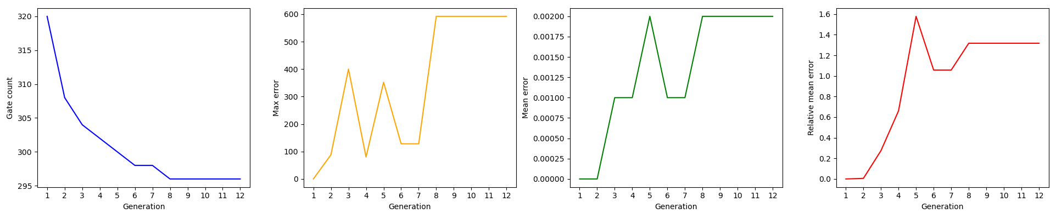
Evaluation: 0.2% error

Slide 7
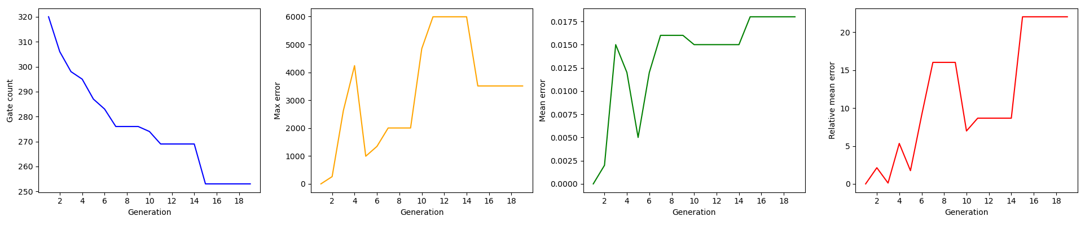
Evaluation: 2% error

Slide 8
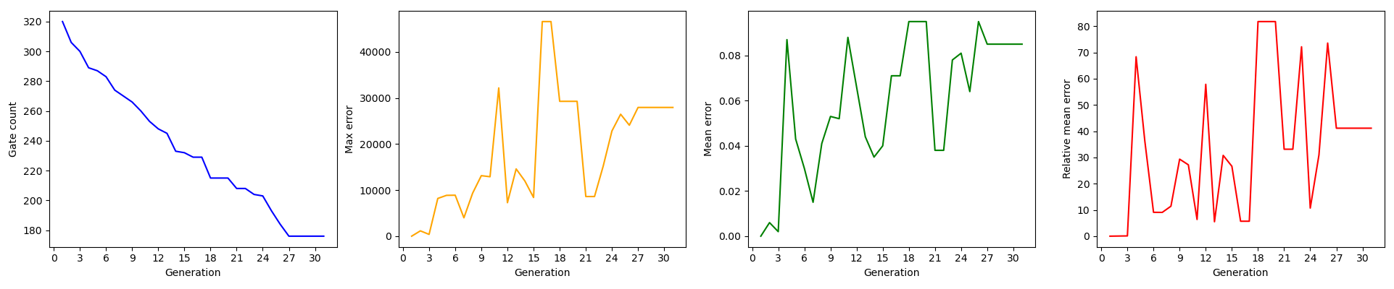
Evaluation: 10% error

Slide 9
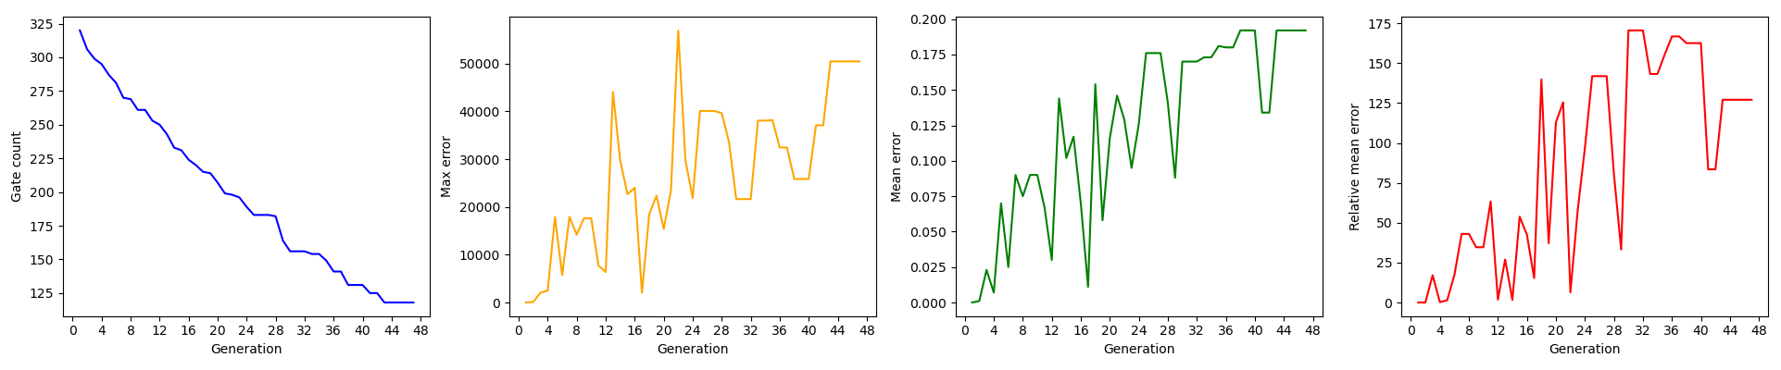
Evaluation: 20% error
more variations of errors and their plots can be found in the documentation

Slide 10
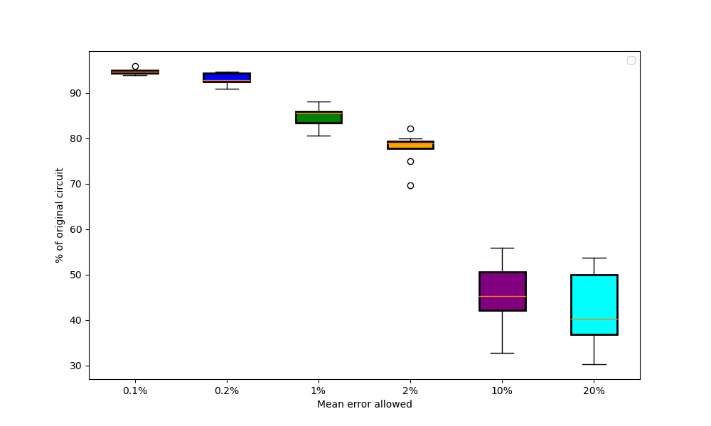
Circuit size vs. Error

Slide 11
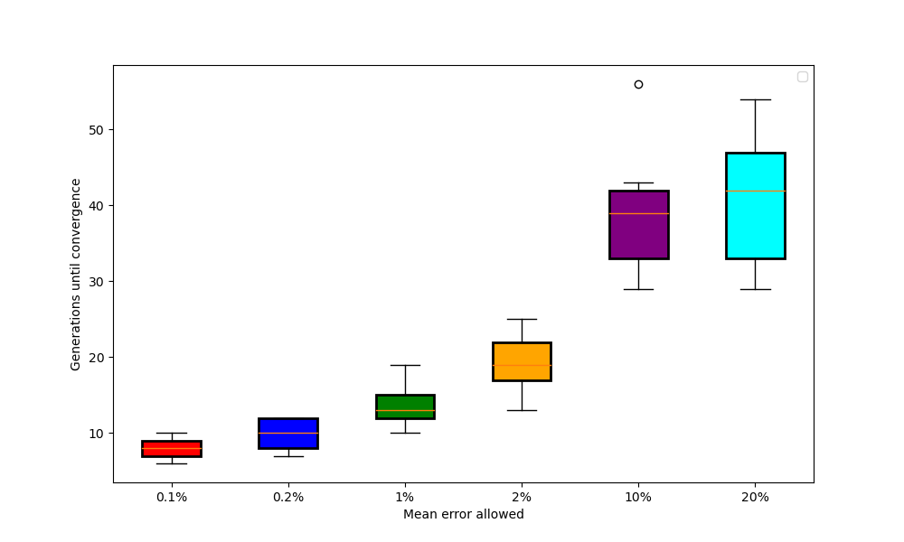
Generations until convergence vs. Error

Slide 12
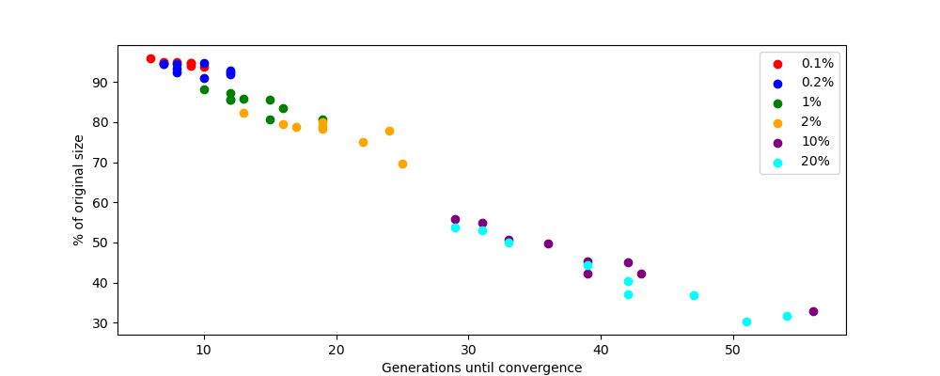
Circuit size vs. Generations

Slide 13
Conclusion
After numerous modifications I managed to set up CGP to do satisfying circuit minimization for different allowed errors. Based on how smooth the curve for gates count is for each error, the chosen CGP parameters proved to be solid, although not perfect, especially on the highest error ends.
Results of runs with 20% error were hurt badly by the increasing possible range of mutations and also the randomness of each mutation.

Slide 14
Conclusion II.
Results from single runs gave mixed results, as you would expect from a GA. Results between runs with errors that were not a magnitude different were indistinguishable.
Based on error spikes, max and mean error are negatively correlated. Mean and mean relative error are positively correlated.
There are of course more things that could be experimented with, for example instead of the number of total gates I could incorporate the depth of a circuit into the fitness function.

